Slide 1



STATE TECHNICAL UNIVERSITY OF QUEVEDO
Topic:
BellChat: An Inclusive Web Application for Messaging.
Bellchat
Lecturer:
Ing. Gleiston Guerrero Ulloa

Slide 2
Bellchat Add-on
Speech recognition: allows us to identify the voice using JavaScript.
Ajax library: allows us to create a JSON structure.
Distributed system: It allows us to run in separate environments connected to a network.
Web content accessibility guidelines: Web content accessibility guidelines provide a shared standard for web content accessibility.
Browser microphone: Allows to obtain the user's requests, in addition to responding also in audio.
Notes:
Bellchat uses several add-ons for their respective functionality, in which are: Web Content Accessibility Guidelines that allows us to design an application with accessibility with the components that are used, the microphone of the browser that is used to obtain the user's requests, in which it has keywords to activate its action, Speech recognition is a voice recognition that allows us to interact with the browser by voice command. Using the Ajax library to create a json structure to make the requests. In addition, designing a distributed system guarantees us to run in different environments our layers and keep working.

Slide 3

Bellchat Architecture
Client
Applications server
Database server
HTML
DBMS protocol
Request
WEB SERVER
CSS
Database
Webservice
JavaScript
web socket
Libraries
Response
Notes:
The architecture is conformed by a client layer that makes the requests, an application server layer where the backend is located waiting for the user's requests and finally the database layer in charge of returning the answers made by the user. With this structure we are guaranteed to obtain a progressive project and if changes are needed, they are made without affecting the other layers.

Slide 4
Client-side programming language
Server-side programming language.
Apache Tomcat used as web server
WebSockets for verifying active sessions and user verification.
Web service for intercommunication and interoperability between networked machines.
Classes developed in a java language to respond to the requested requests.
The client-side web application is managed within HTML pages, which are displayed on the server.
User actions, such as text input or voice control, are handled with JavaScript language.
Notes:
We use JavaScript on the client side to interact with both the HTML components and others to obtain, send and display information needed by the user. On the server side we use java to respond to requests from the client layer.

Slide 5
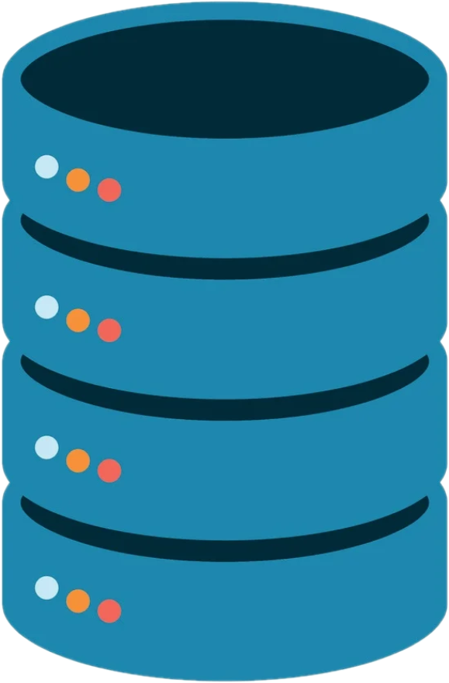
Database manager
Related tables
Functions that receive parameters to perform operations.
Notes:
We use a database to store all the information such as: user's personal data, type of disability, contacts, messages, with the respective functions performed we will answer the requests made by the application server layer.

Slide 6
Web application

Slide 7
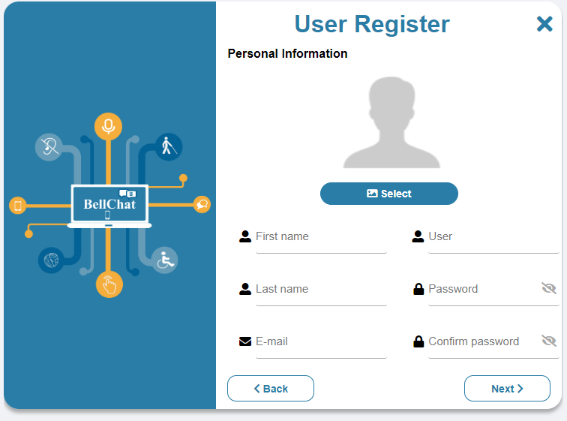
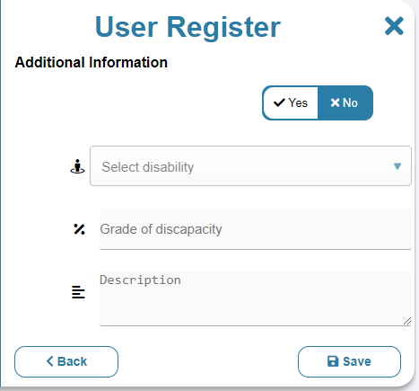
Register user
Notes:
Para el registro, los usuarios pueden utilizar los comandos por voz o escribir directamente el teclado. Lo hace en dos pasos. El primero para los datos de identificación, y el segundo para los datos de su discapacidad si la tuviera.

Slide 8
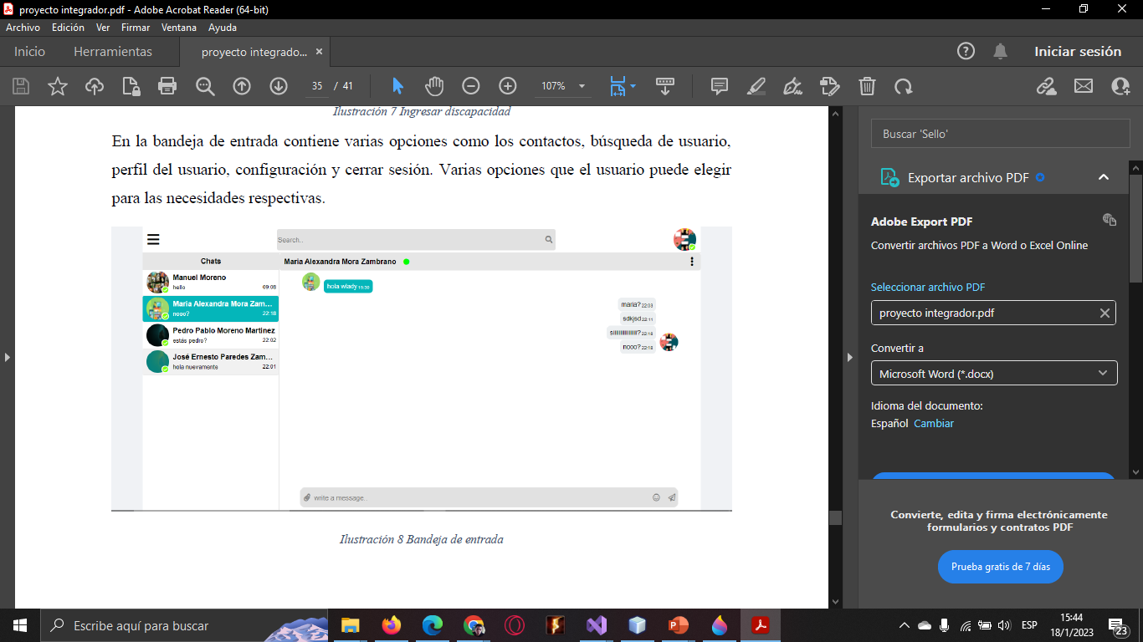
Inbox
Notes:
La interfaz para establecer con sus contactos. En la imagen se muestra la interfaz para una persona con discapacidad auditiva, donde los mensajes se muestran en texto (en este caso tal cuál fueron enviados).

Slide 9
¡¡ THANK YOU!!

